Slide 1
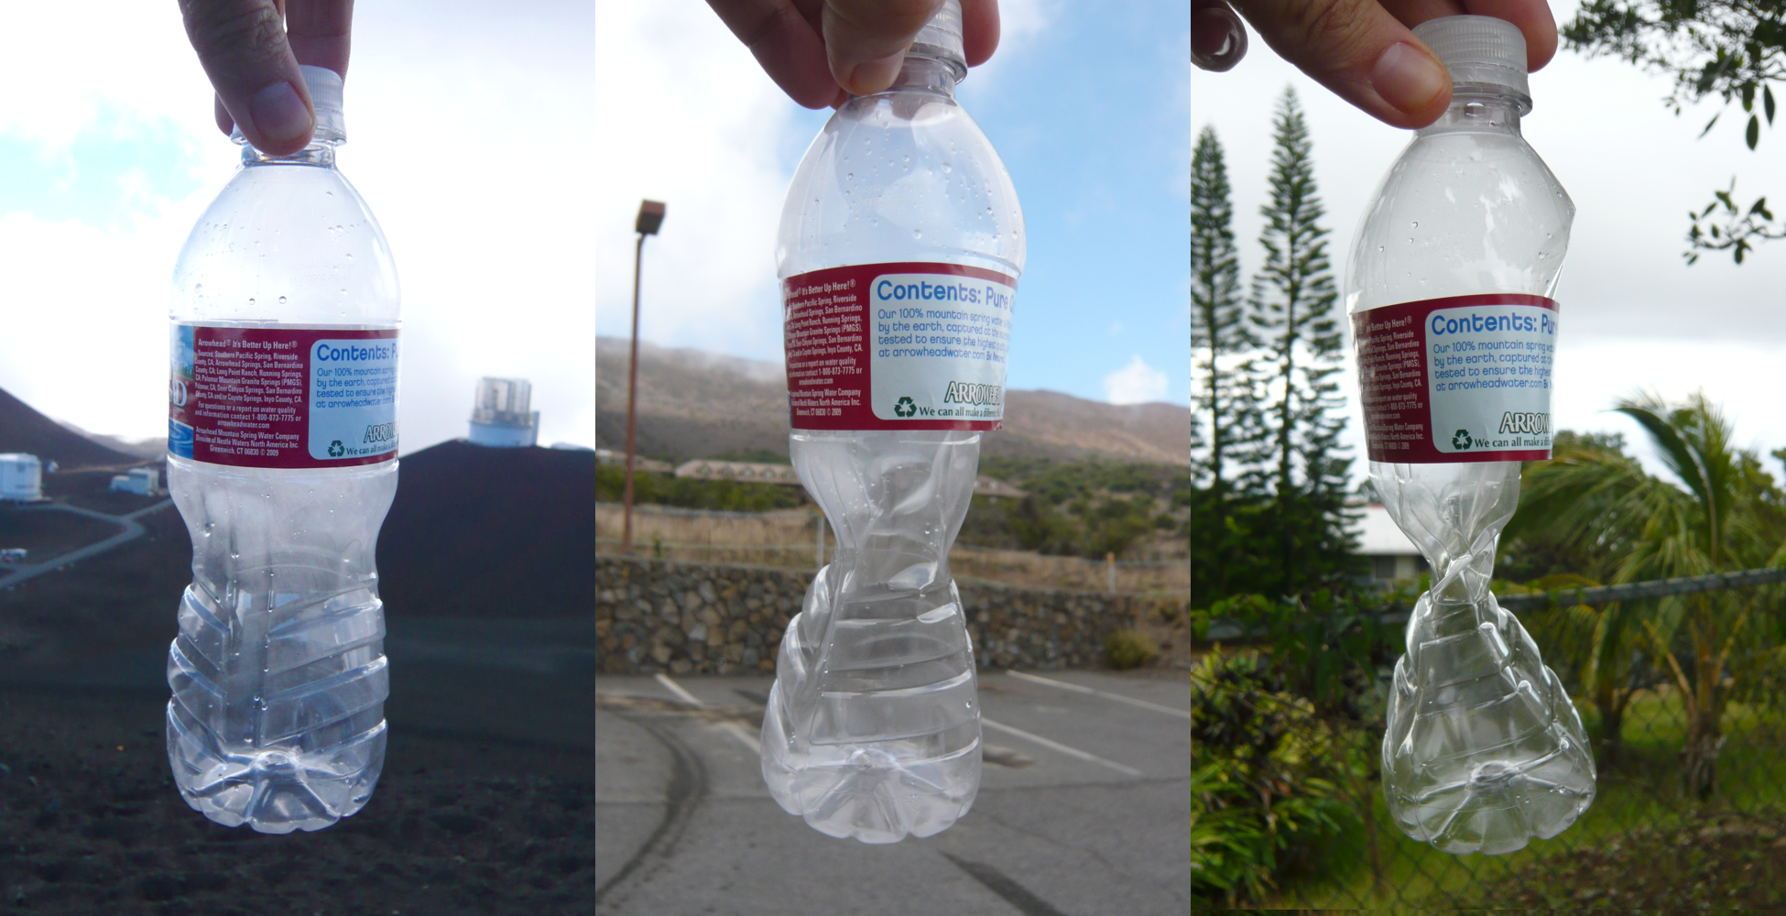

Slide 2
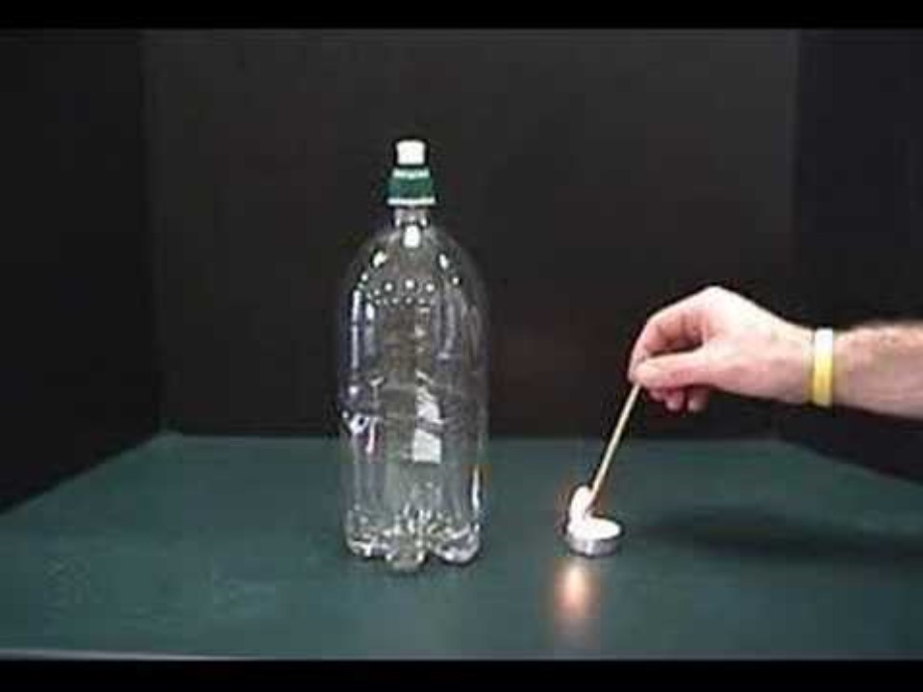

Slide 3
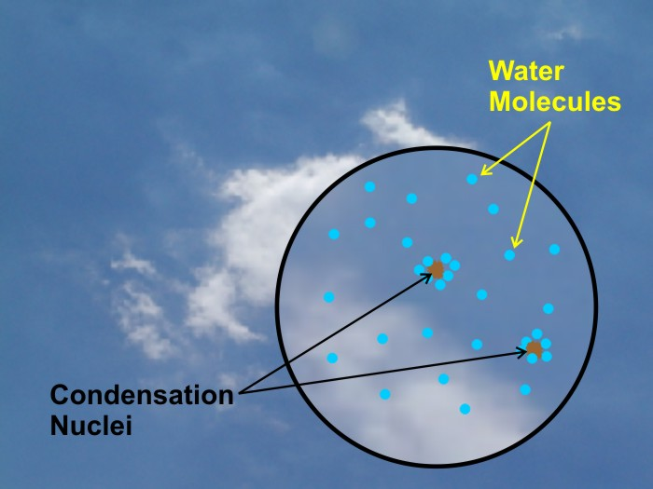

Slide 4
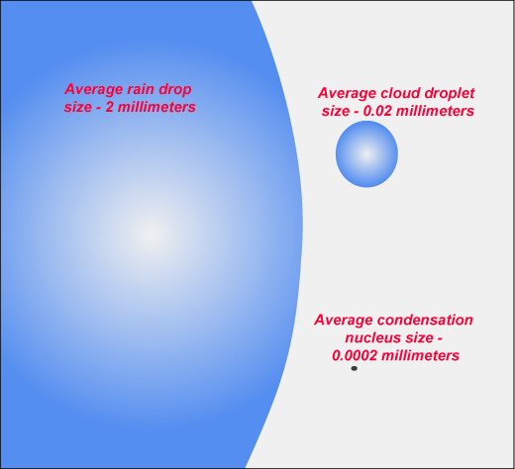

Slide 5
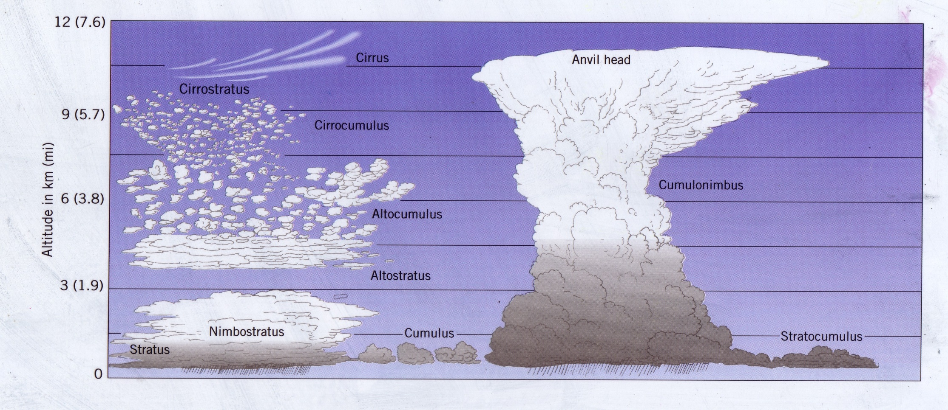

Slide 6
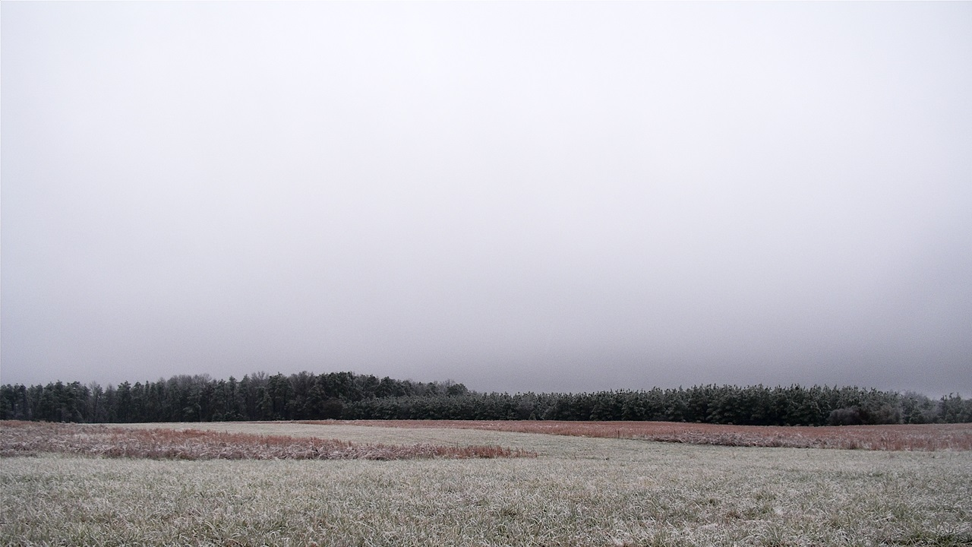
Stratus
Notes:
Stratus

Slide 7
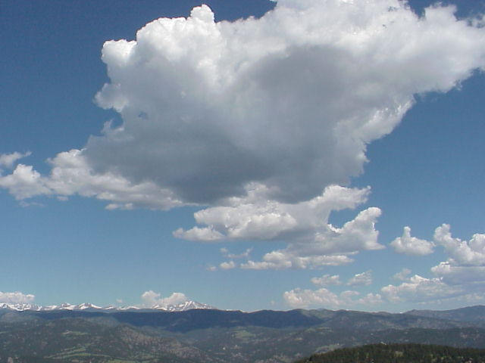
Cumulus
Notes:
Cumulus

Slide 8
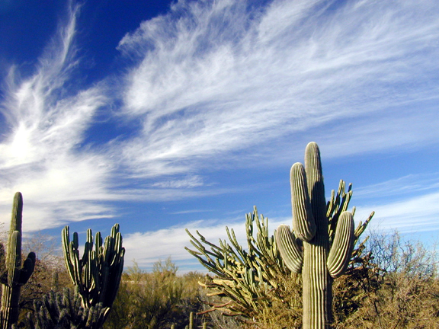
Cirrus
Notes:
Cirrus

Slide 9

Cirrostratus
Notes:
Cirrostratus

Slide 10
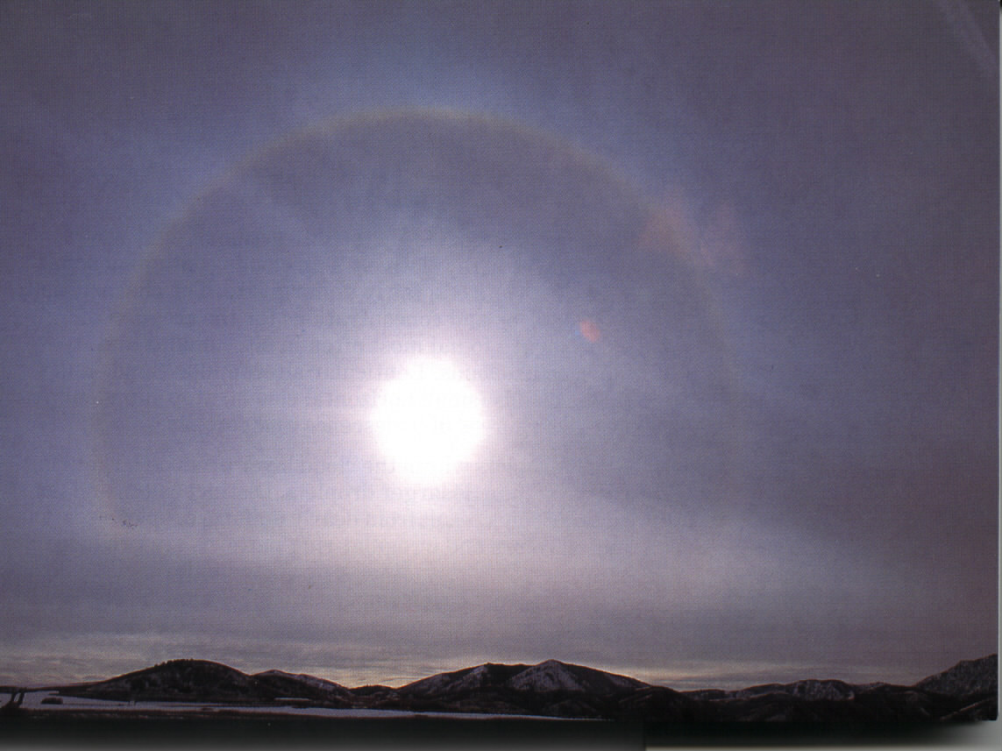
Cirrostratus
Notes:
Cirrostratus

Slide 11
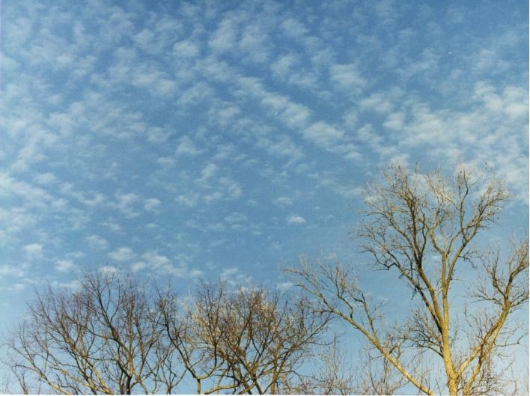
Cirrocumulus
Notes:
Cirrocumulus

Slide 12
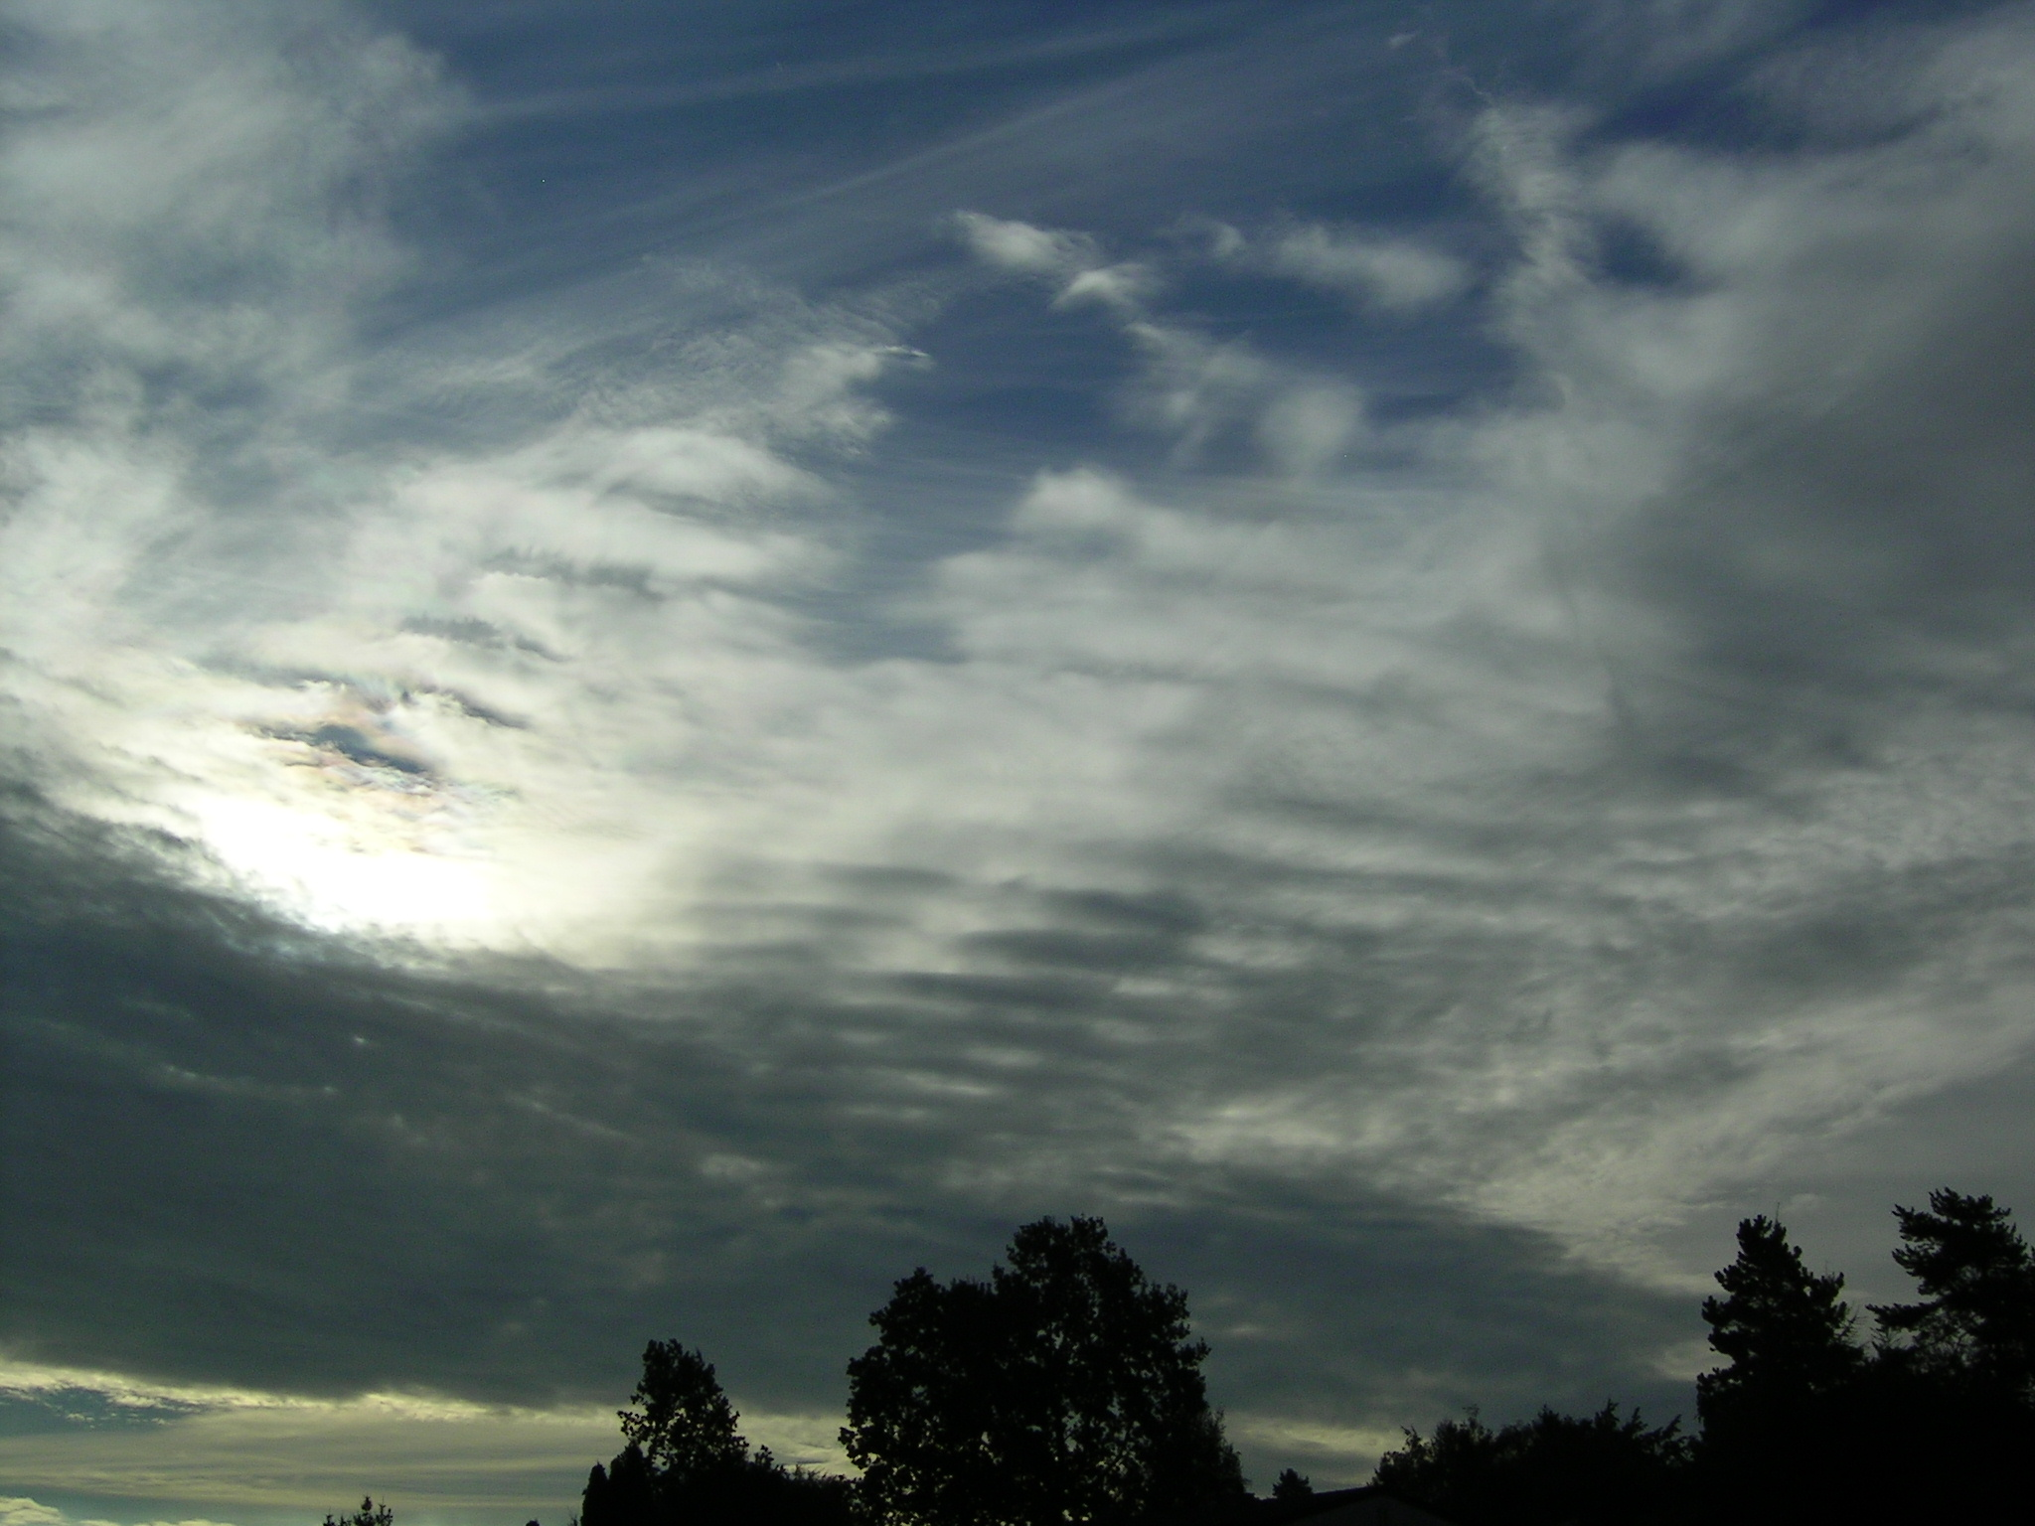
Altostratus (and cirrus, higher)
Notes:
Altostratus (and cirrus, higher)

Slide 13
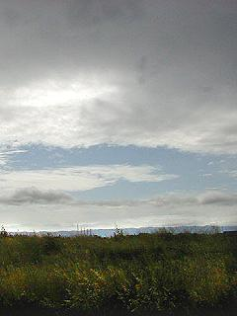
Altostratus
Notes:
Altostratus

Slide 14
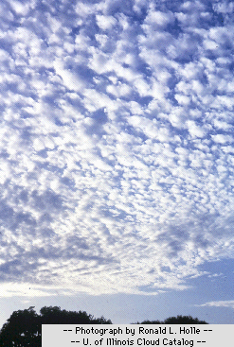
Altocumulus
Notes:
Altocumulus

Slide 15
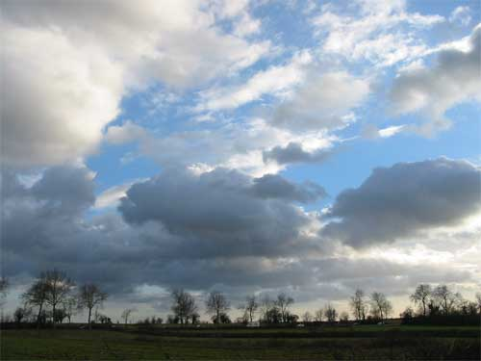
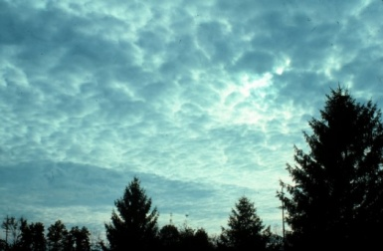
Stratocumulus
Notes:
Stratocumulus

Slide 16
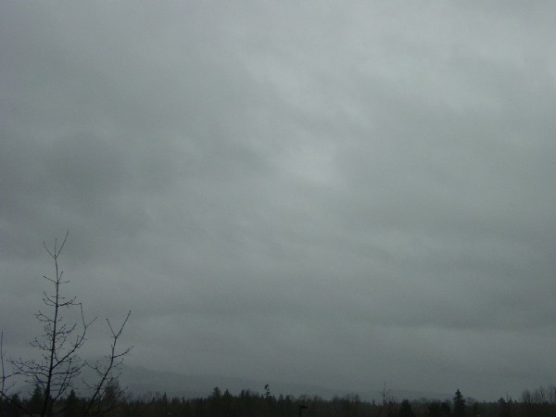
Nimbostratus
Notes:
Nimbostratus

Slide 17
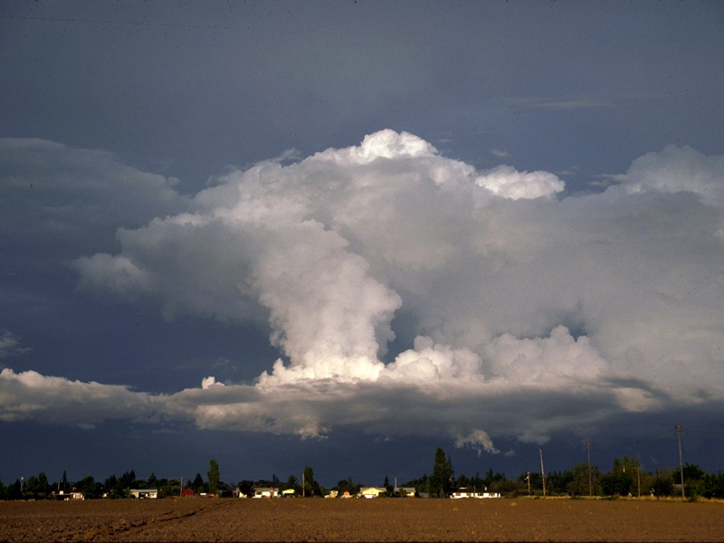
Cumulonimbus
Notes:
Cumulonimbus

Slide 18
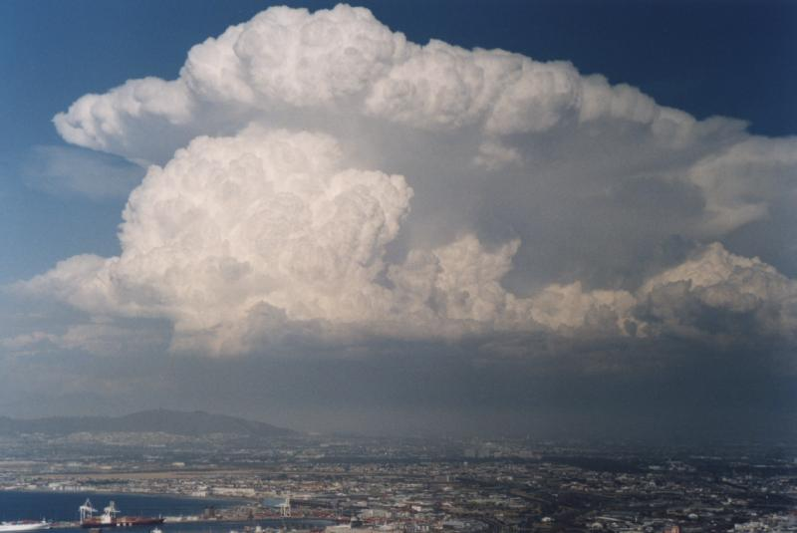
Cumulonimbus
Notes:
Cumulonimbus

Slide 19
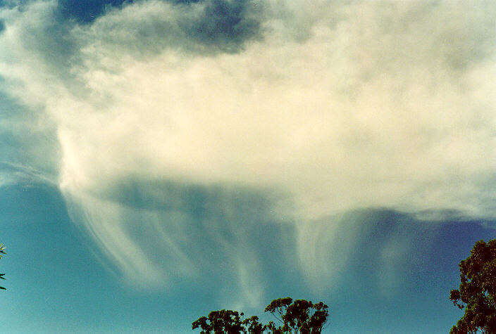
Virga
Notes:
Virga

Slide 20
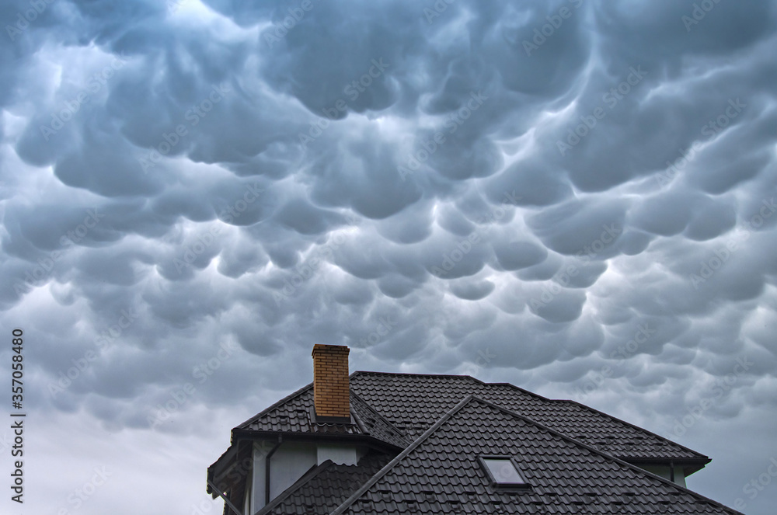
Mammatus
Notes:
These clouds typically appear during thunderstorms and cumulonimbus clouds

Slide 21
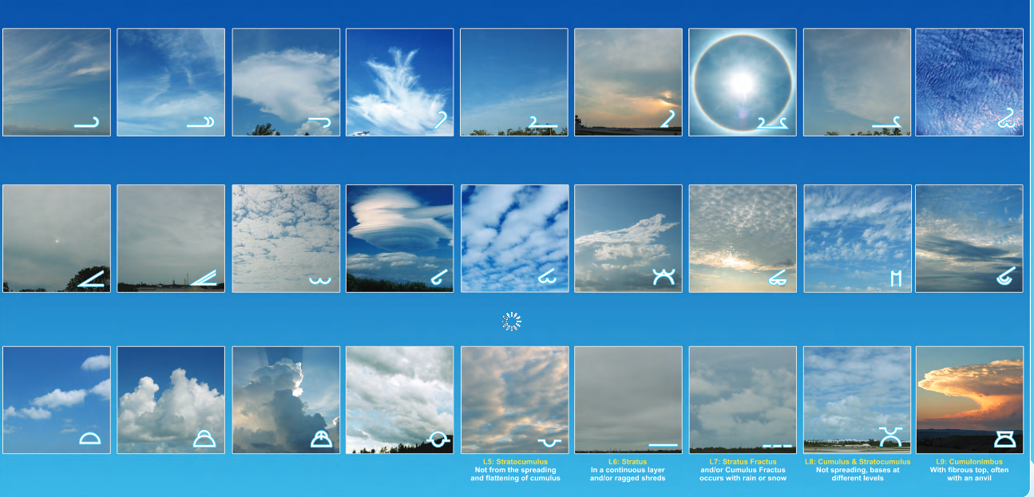
NOAA Cloud Chart: https://www.noaa.gov/jetstream/clouds/nws-cloud-chart
Notes:
https://cloudappreciationsociety.org/

Slide 22
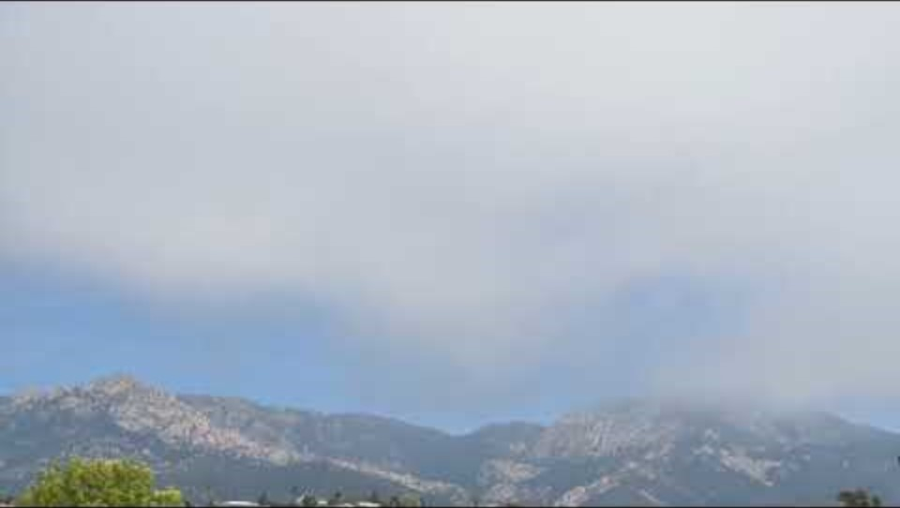

Slide 23
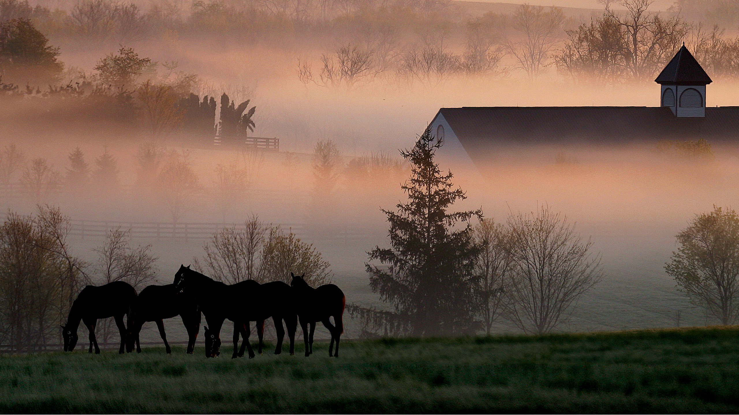
Inland radiation fogs (Kentucky) occur on clear nights when the air at the surface cools to the dew point and if humid air is present it will condense and form tiny droplets that comprise the fog.
Inland radiation fog
Notes:
Inland radiation fog

Slide 24
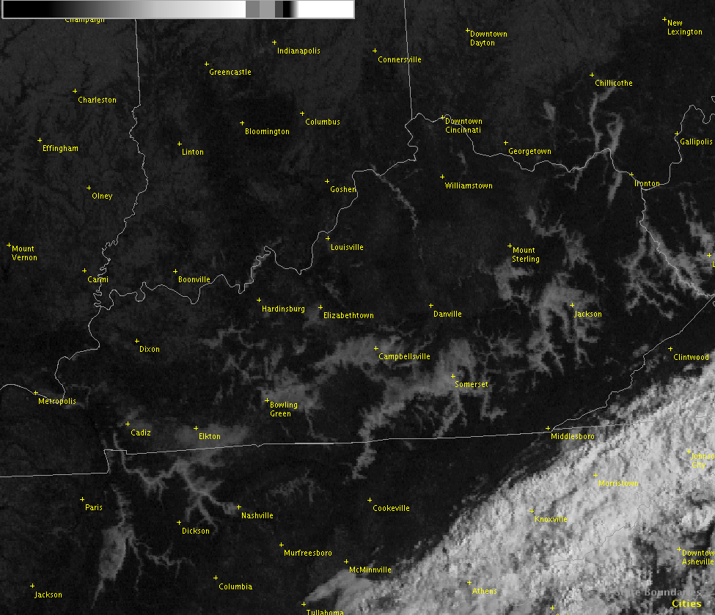
Inland radiation fog, Kentucky

Slide 25
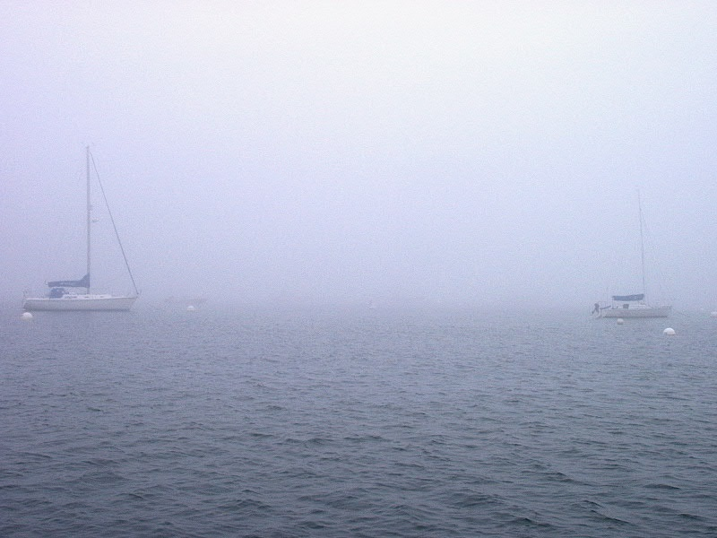
Evaporation fogs (Maine) form when warm water contributes water vapor to cold air above it, which allows the air to cool to its dew point, reach saturation, and condensate as tiny water droplets.
Notes:
Maine evaporation fog

Slide 26
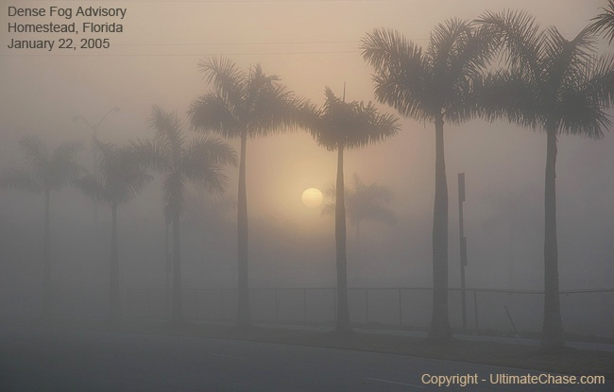
Evaporation fog, south Florida

Slide 27
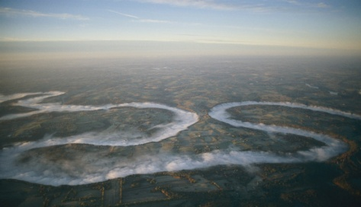
Evaporation fog, Kentucky
Notes:
Kentucky River

Slide 28
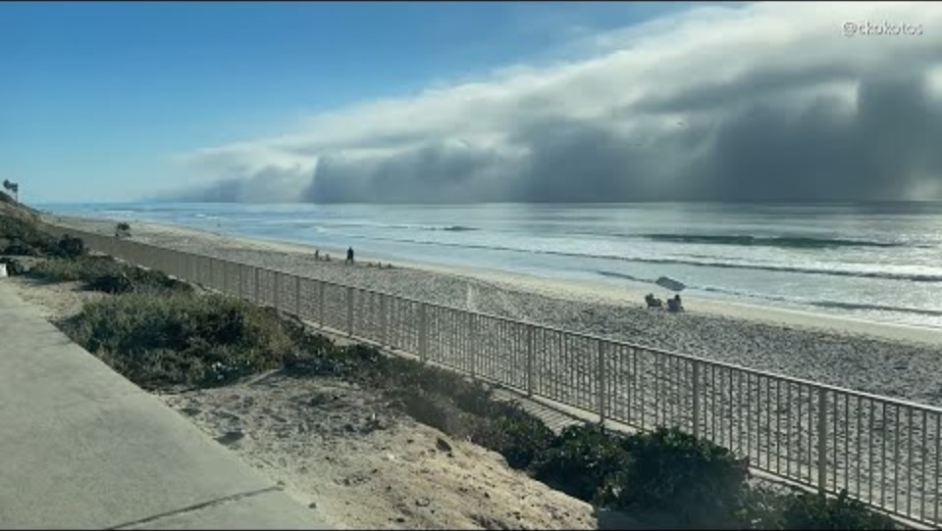
Notes:
California; advection fog

Slide 29
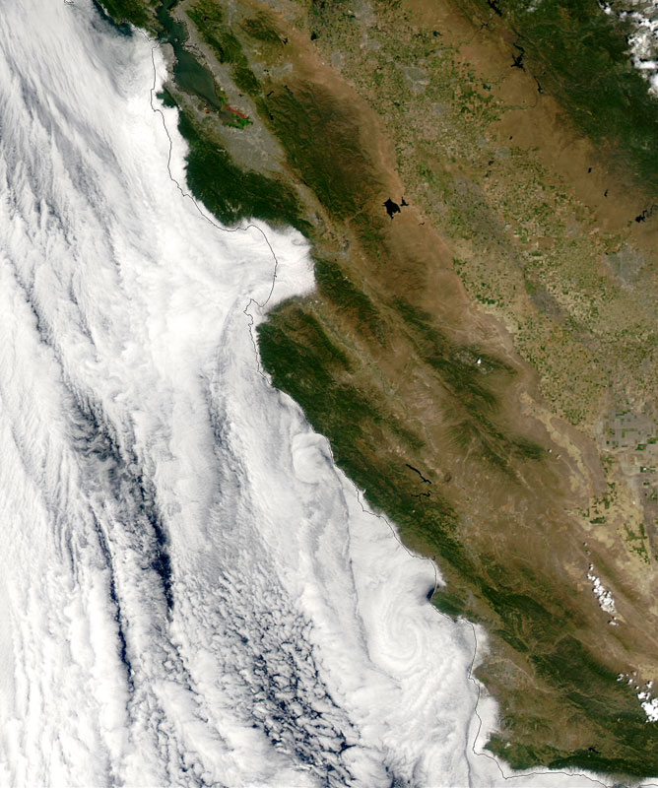
Advection fogs like those in California form when cold ocean currents cause the air above it to cool and reach its dew point and condensate. When the inland reaches warm up during the day and form a low pressure, a sea breeze blows inland, from the ocean to the land, advecting (blowing) this fog inland.

Slide 30


Slide 31
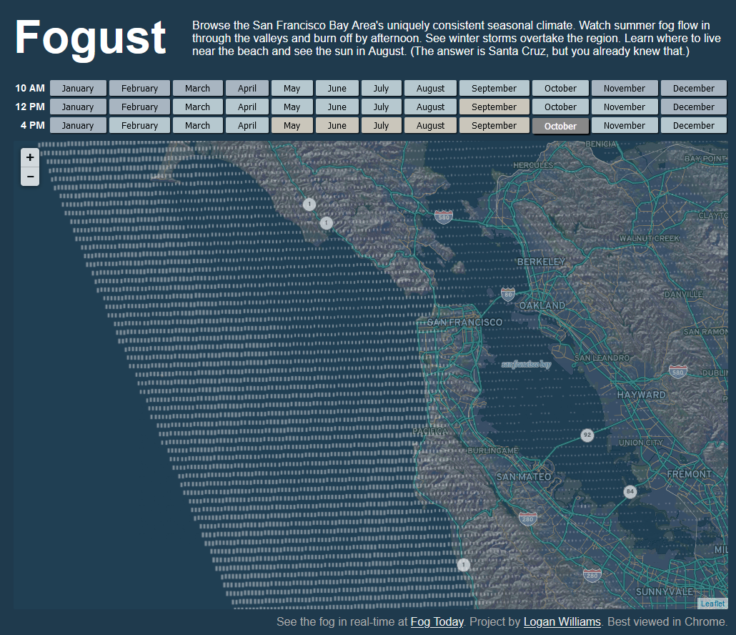
Notes:
https://fog.today/fogust/

Slide 32
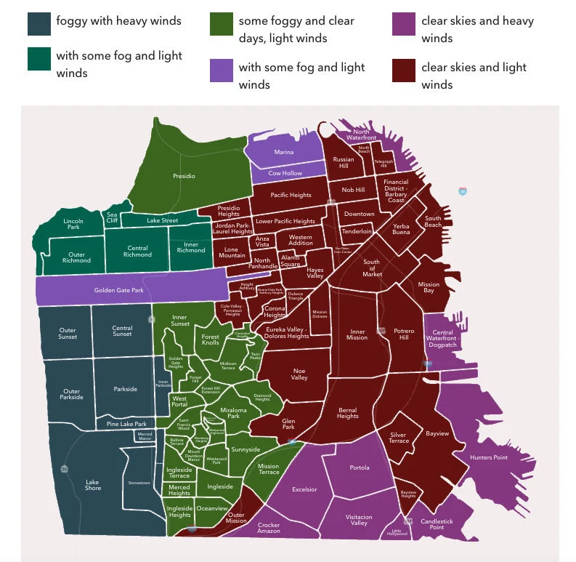
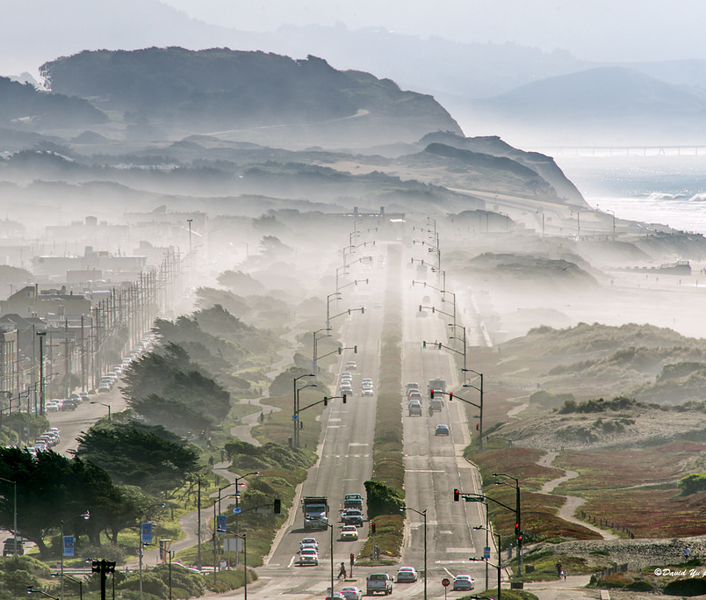

Slide 33


Slide 34
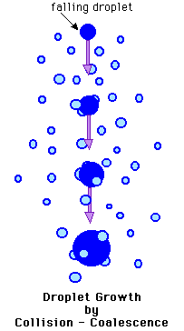

Slide 35
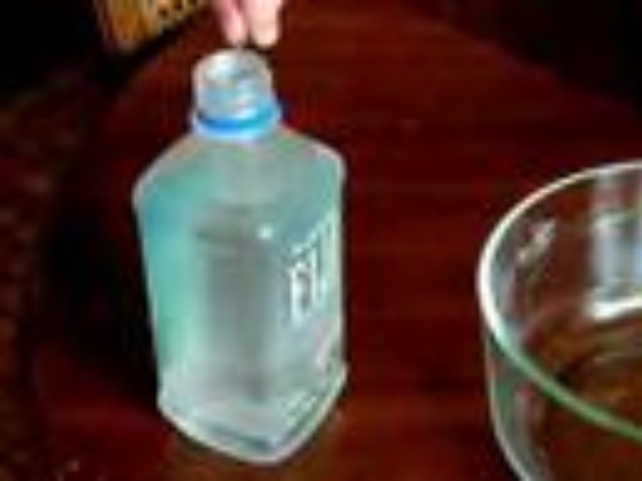

Slide 36
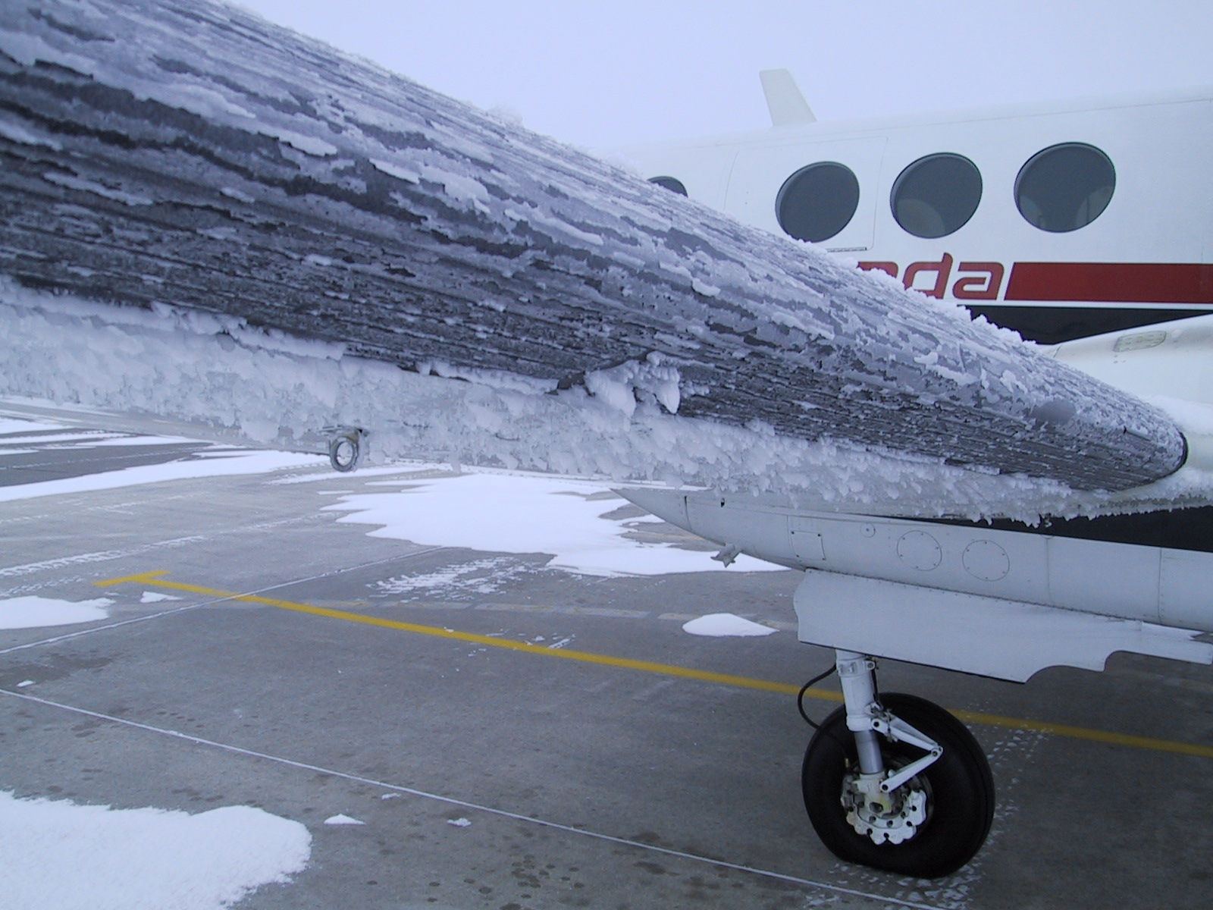

Slide 37
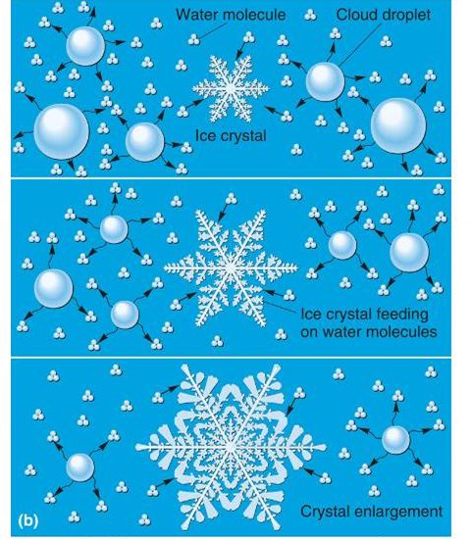

Slide 38
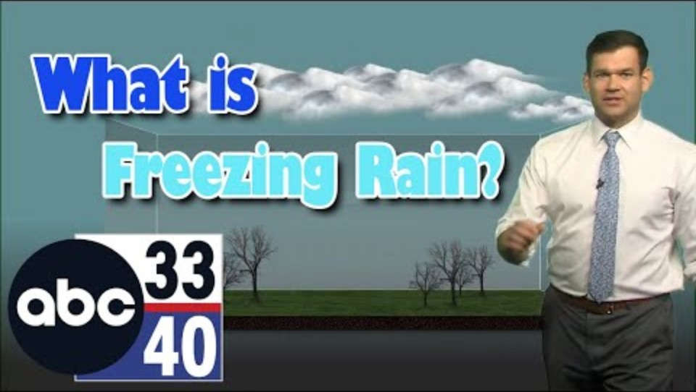

Slide 39
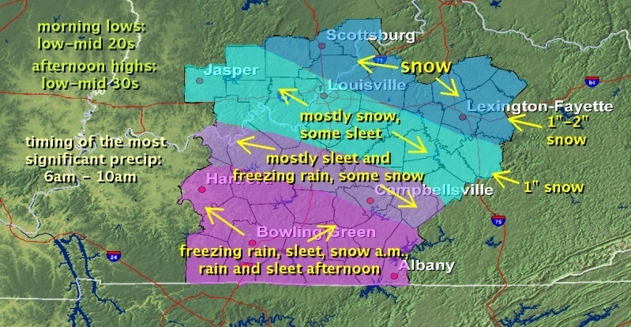

Slide 40
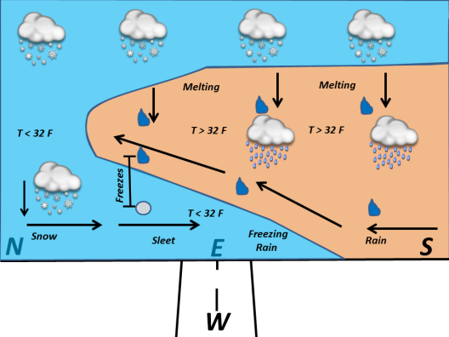

Slide 41
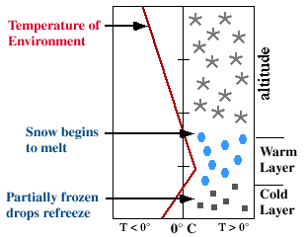
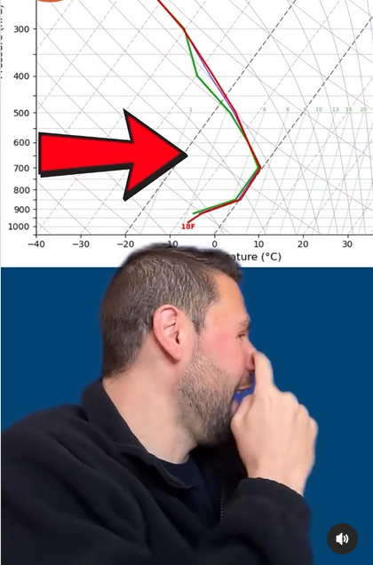
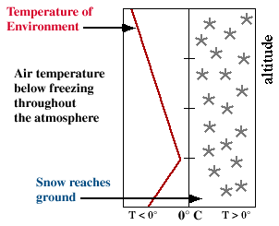
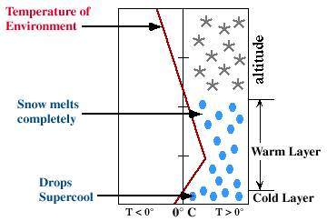
Sleet profile
Snow profile
Freezing rain profile

Slide 42
